Slide 1
Statistics
Saravana

Slide 2
Statistics – it’s the science of Collecting, Organizing, Summarising, analysing and interpreting Data.
Goal is to make use of imperfect information (data) to infer facts, make conclusions, and make predictions.
Example – Salaries of the IPL Players in India

Slide 3
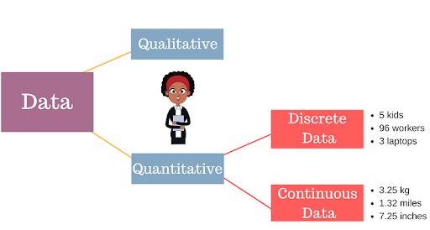
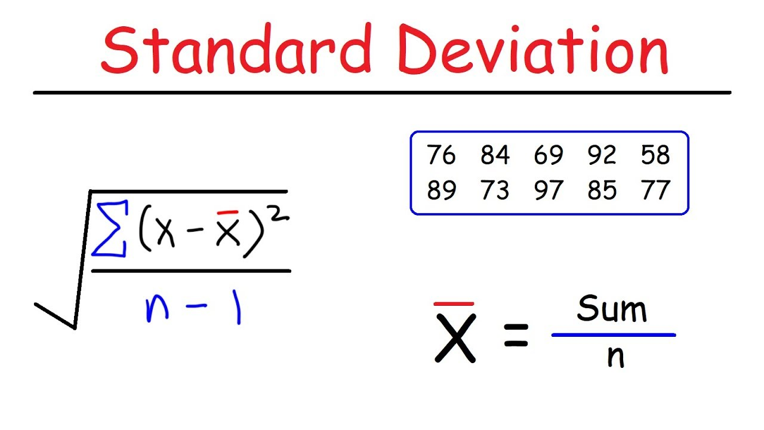
Basics of Statistics
Continuous Vs Discrete
What is Distribution
What is Standard Deviation
Normal Distribution
Skewness

Slide 4
Statistics
Surveys – Data collected on Individuals
Experiments – One or more treatment
Descriptive Statistics
Charts & Graphs
Inferential Statistics
Sampling
Analysing Data
Making Conclusions

Slide 5
Descriptive Statistics
Types of Data
Measures of Frequency: * Count, Percent, Frequency. ...
Measures of Central Tendency. * Mean, Median, and Mode. ...
Measures of Dispersion or Variation. * Range, Variance, Standard Deviation. ...
Measures of Position. * Percentile Ranks, Quartile Ranks.

Slide 6
Charts & Graphs
Pie Charts
Time Charts
Bar Graph
Histograms
Boxplots

Slide 7
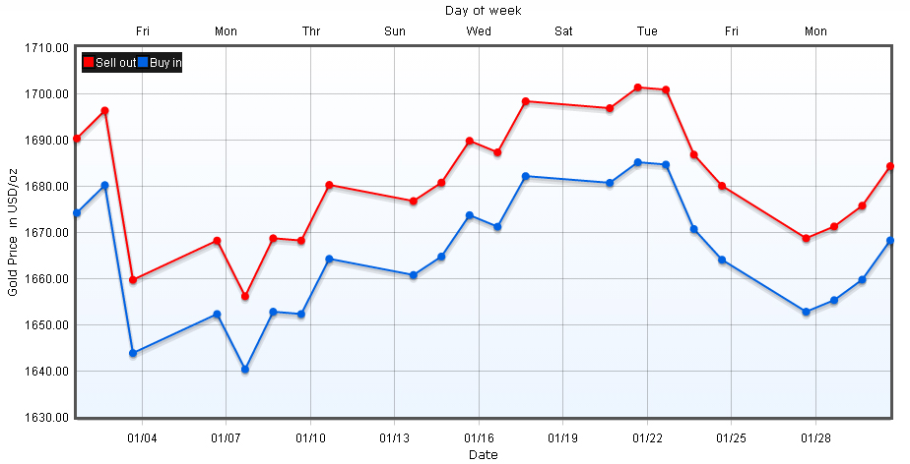
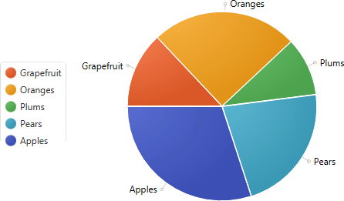
Time Chart & Pie chart

Slide 8
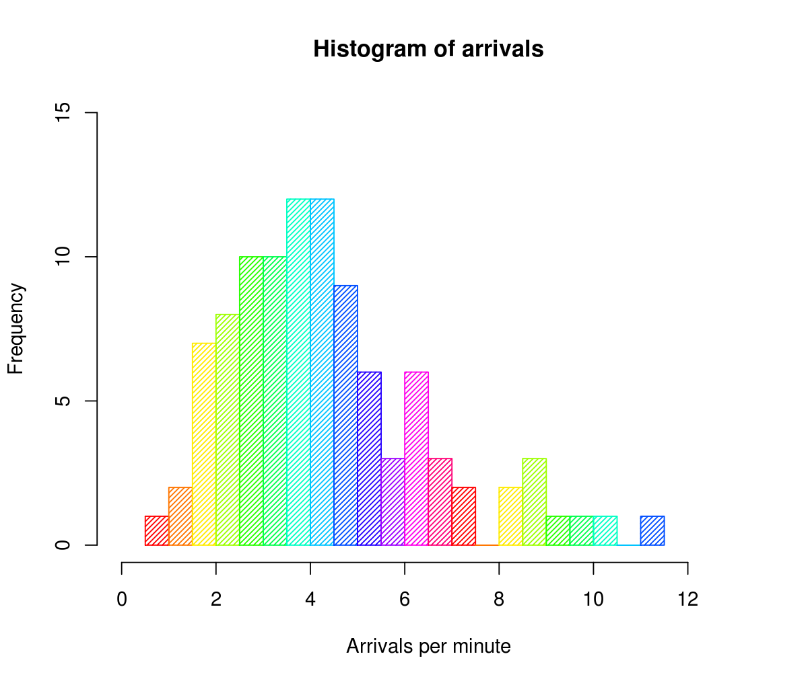
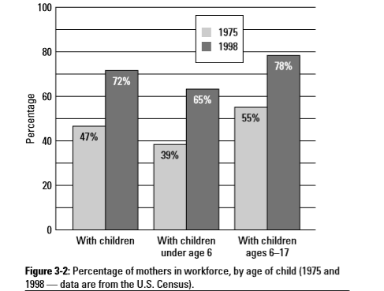
Bar chart & histogram

Slide 9
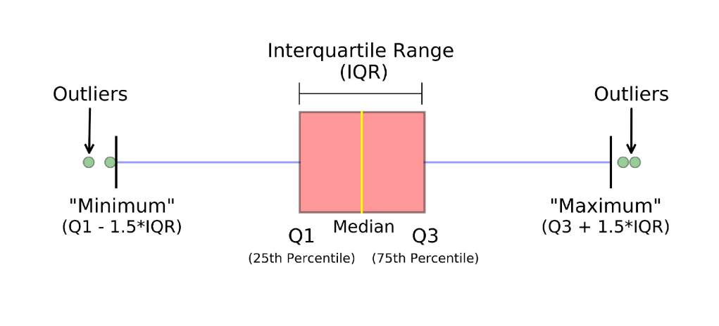
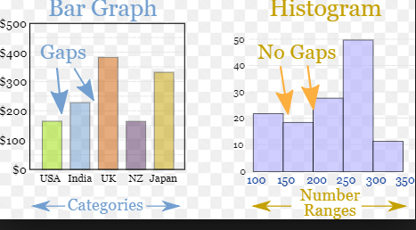
Box-plot

Slide 10
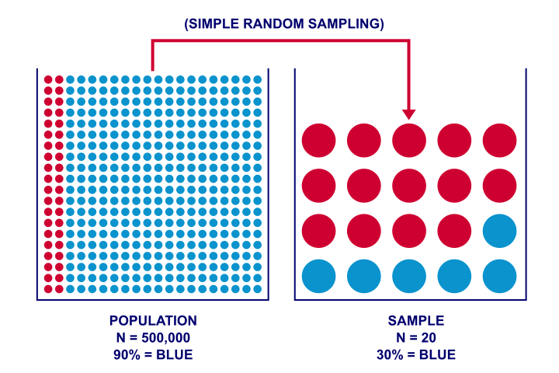
INFERENTIAL STATISTICS
Inferential statistics use a sample of data taken from a population to describe and make inferences about the population

Slide 11
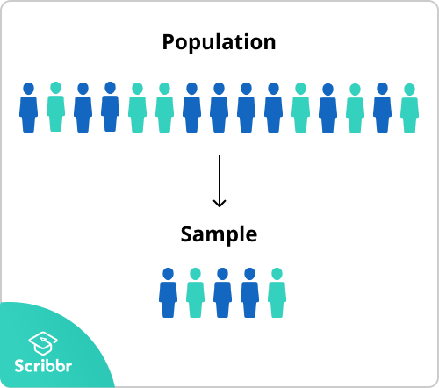
Sampling
Sampling is a process used in statistical analysis in which a predetermined number of observations are taken from a larger population. The methodology used to sample from a larger population depends on the type of analysis being performed, but it may include simple random sampling or systematic sampling

Slide 12
Sampling methods
Probability Sampling
Simple Random Sampling
Systematic Sampling
Stratified Sampling
Cluster Sampling
Non-Probability Sampling
Convenient Sampling
Quota Sampling
Judgement Sampling
Snowball Sampling

Slide 13
Bias in Sampling
Any pre-agreed sampling rules are deviated from
People in hard-to-reach groups are omitted
There are low response rates
An out-of-date list is used as the sample frame (for example, if it excludes people who have recently moved to an area)

Slide 14
Probability
Three basic properties of probability
Property 1: The probability of an event is always between 0 and 1, inclusive
Property 2: The probability of an event that cannot occur is 0. Please note that an event that cannot occur is called an impossible event.
Property 3: The probability of an event that must occur is 1. An event that must occur is called a certain event.
The simplest example is a coin flip.

Slide 15
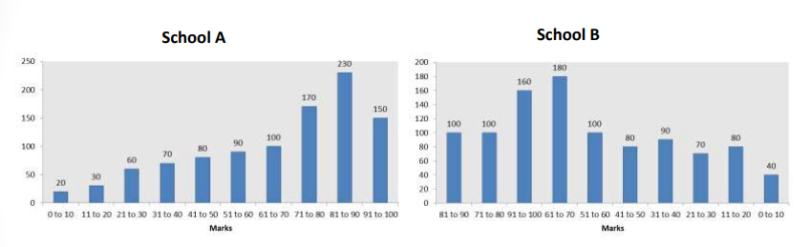
Distribution
Results of a mathematics test marks from last 10 years
Which school is better?
If we are going to conduct another test, how many students can be expected to score 91 to 100 from school A & from school B
This is a frequency distribution of marks.
What is the probability that a student will score more than 50 from school A & from School B?

Slide 16
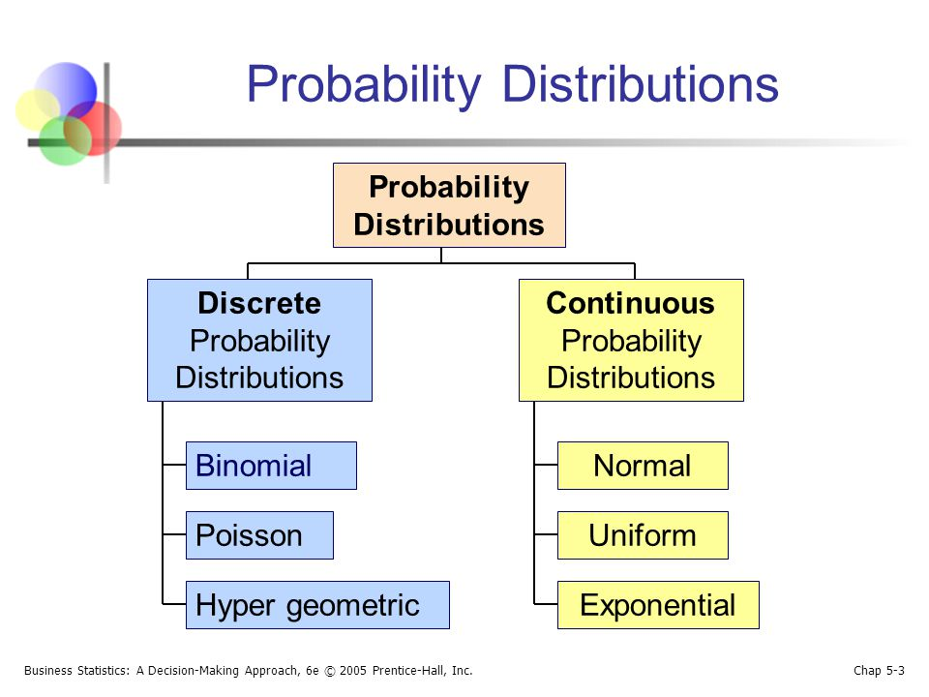
DISTRIBUTIONS
Bernoulli Distribution

Slide 17
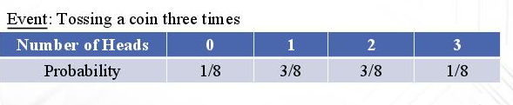
Descrete Probability Distribution
It describes the probability of occurrence of each value of a discrete random variable

Slide 18
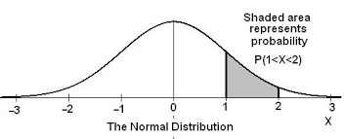
Continuous probability distribution
The Probability of a random variable assuming a value between a given interval
Continuous distributions are constructed from continuous random variables
They are generated from experiments or processes that create outcomes that are measured as opposed to counted.

Slide 19
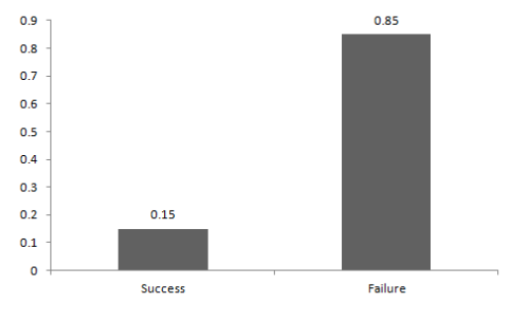
Bernoulli Distribution
A Bernoulli distribution has only two possible outcomes, namely 1 (success) and 0 (failure), and a single trial.

Slide 20
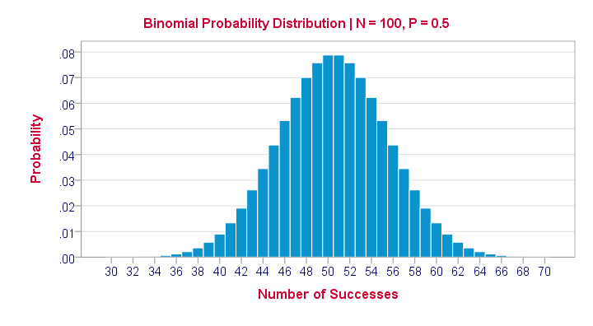
Binomial Distribution
Characteristics of a Binomial A random variable has a binomial distribution if all of following conditions are met:
1. There are a fixed number of trials (n).
2. Each trial has two possible outcomes: success or failure.
3. The probability of success (call it p) is the same for each trial.
4. The trials are independent, meaning the outcome of one trial doesn’t influence that of any other.

Slide 21
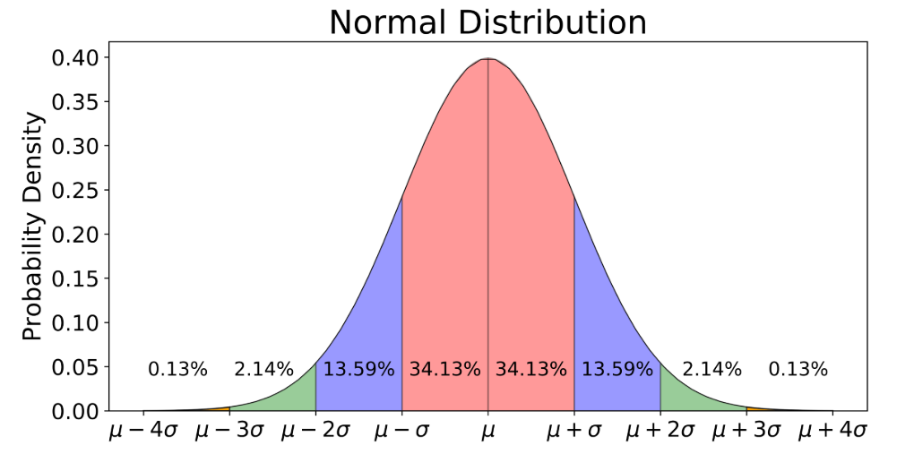
Normal Distribution
It’s a probability distribution that is symmetric about the mean, showing that data near the mean are more frequent in occurrence than data far from the mean

Slide 22
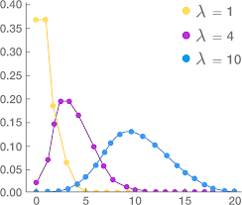
Poisson Distribution
The Poisson distribution is the discrete probability distribution of the number of events occurring in a given time period, given the average number of times the event occurs over that time period
A certain fast-food restaurant gets an average of 3 visitors to the drive-through per minute. This is just an average, however. The actual amount can vary.
This information can, in turn, help a manager plan for these events with staffing and scheduling.

Slide 23
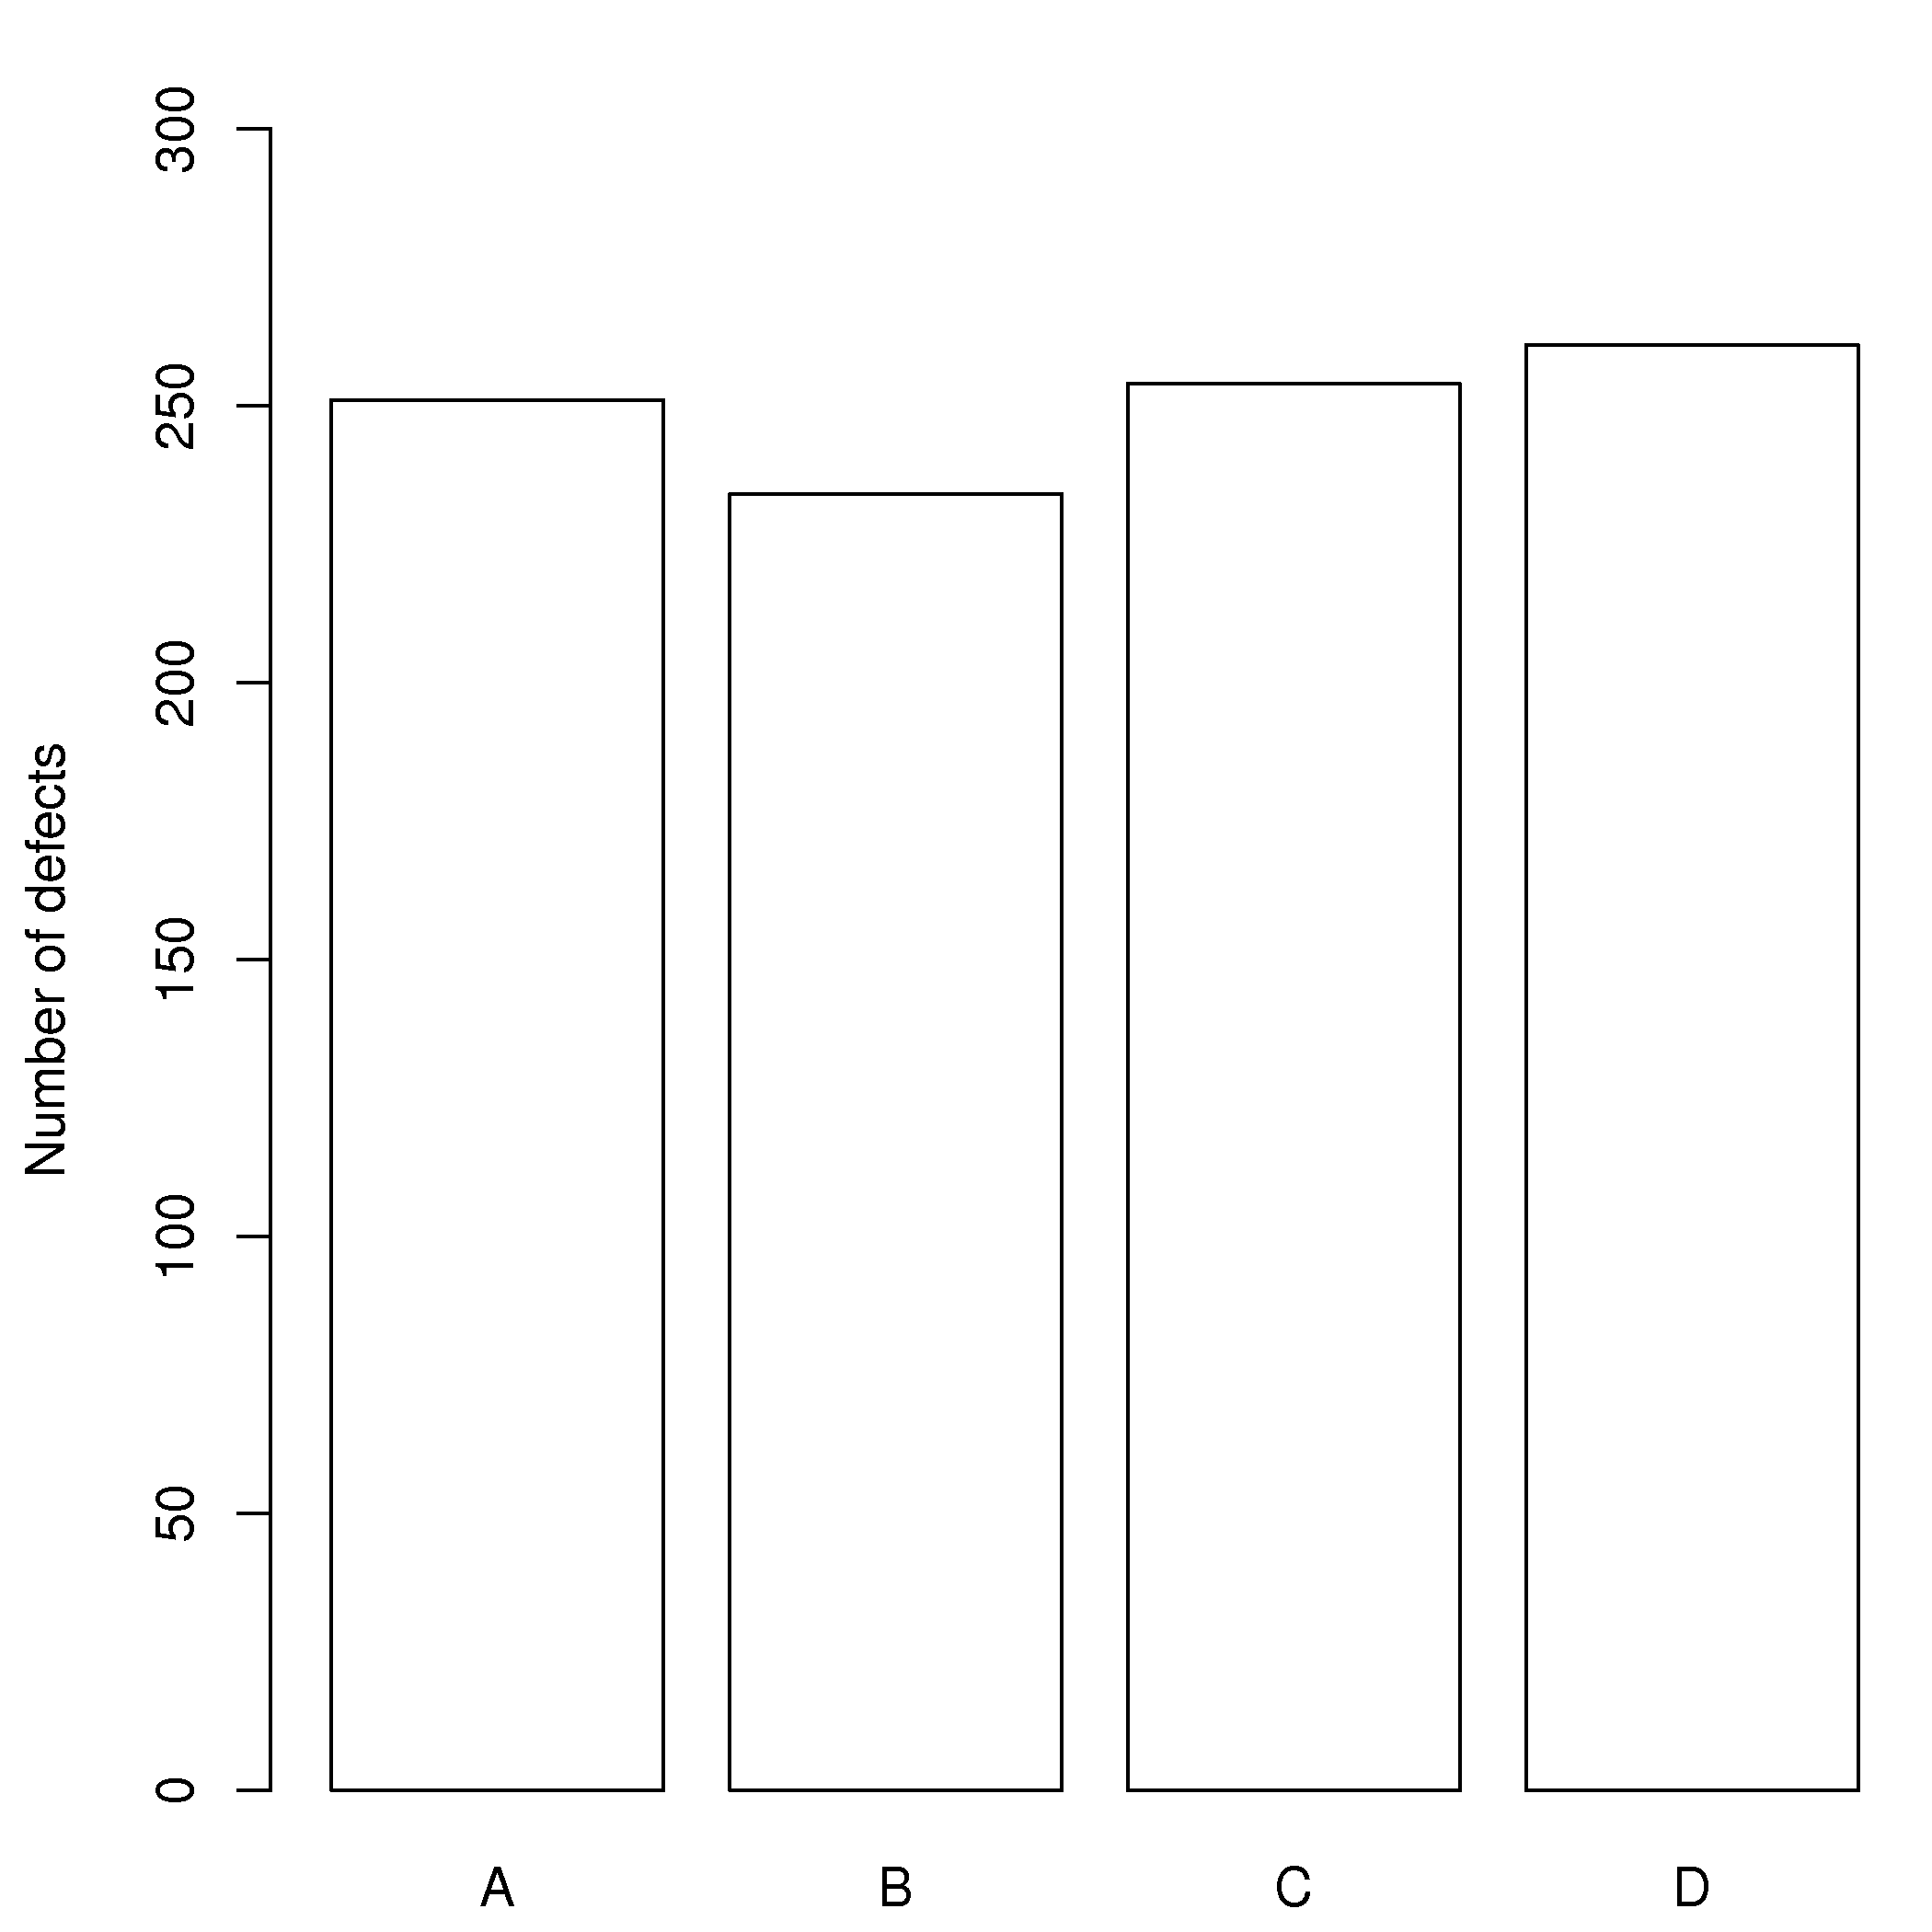
Uniform distribution
A uniform distribution, sometimes also known as a rectangular distribution, is a distribution that has constant probability.

Slide 24
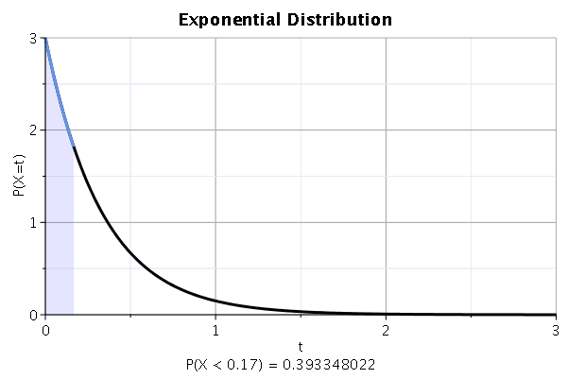
Exponential Distribution
The probability distribution of the time between events, a process in which events occur continuously and independently at a constant average rate.

Slide 25
Hypothesis Tests
A statement that might be true, which might then be tested.
Example: Sham has a hypothesis that "large dogs are better at catching tennis balls than small dogs". We can test that hypothesis by having hundreds of different sized dogs try to catch tennis balls.
Null-Hypothesis – Application of bio-fertilizer do not increase the plant growth
Alternate-Hypothesis – Application of bio-fertilizer does increase the plant growth

Slide 26
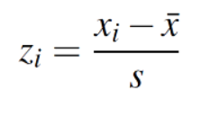
Z Score
Simply put, a z-score is the number of standard deviations from the mean a data point is.
let’s say you have a test score of 190. The test has a mean (μ) of 150 and a standard deviation (σ) of 25. Assuming a normal distribution, your z score would be: z = (x – μ) / σ = 190 – 150 / 25 = 1.6. The z score tells you how many standard deviations from the mean your score is. In this example, your score is 1.6 standard deviations above the mean.

Slide 27
T-Distribution
The T Statistic is used in a T test when you are deciding if you should support or reject the null hypothesis. It’s very similar to a Z-score and you use it in the same way: find a cut off point, find your t score, and compare the two. You use the t statistic when you have a small sample size, or if you don’t know the population standard deviation.
For example, the average IQ is 100. You can test a class of children with a mean score of 90 to see if that’s significant, or if it just happened by chance.

Slide 28
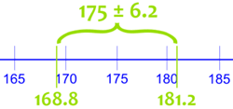
Confidence Intervals
We measure the heights of 40 randomly chosen men, and get a mean height of 175cm,
We also know the standard deviation of men's heights is 20cm.
The 95% Confidence Interval is:
This says the true mean of ALL men (if we could measure all their heights) is likely to be between 168.8cm and 181.2cm.
But it might not be!
The "95%" says that 95% of experiments like we just did will include the true mean, but 5% won't.
So there is a 1-in-20 chance (5%) that our Confidence Interval does NOT include the true mean.

Slide 29
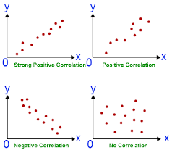
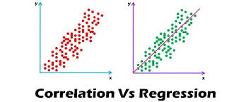
Correlation & Regression

Slide 30
Thanks

